Slide 1
IPSec
ICT Security Project
Muhammad Abeer Khan
Applied Data Science

Slide 2
IP Security (IPsec) is defined by the IETF to provide interoperable, high-quality, cryptography-based security for IP communications.
It is a Layer 3 VPN technology that transmits data in a secure channel established between two endpoints (such as two security gateways).
Such a secure channel is usually called an IPsec tunnel.

Slide 3
3 Main security services that IPSec VPN provides are
Peer Authentication
Data Confidentiality
Data Integrity

Slide 4
Peer Authentication
Authentication is used to recognize a user's identity. The sender and receiver will authenticate each other to make sure that they are really talking with the Party they intend to.
Data Confidentiality
Confidentiality refers to protecting the information from disclosure to unauthorized parties.
By encrypting the data, nobody except the sender and receiver will be able to read our data.
Data Integrity
Integrity of information refers to protecting information from being modified by unauthorized parties. By calculating a hash value, the sender and receiver will be able to check if changes have been made to the packet.
Anti-replay
An attacker could try to capture these packets and send them again. Sequence numbers is used to avoid it. IPsec will not transmit any duplicate packets.

Slide 5
3 Main protocols used in IPsec are
Internet Key Exchange (IKE)
IPsec Authentication Header (AH)
Encapsulating Security Payload (ESP)

Slide 6
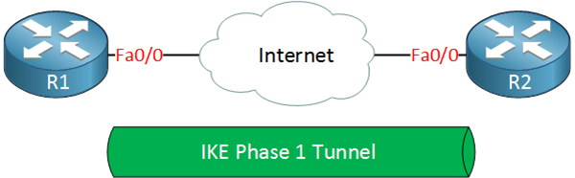
IKE Phase 1
The primary purpose of IKE phase 1 is to authenticate the IPsec peers and to set up a secure channel between the peers for IKE exchanges to take place. IKE phase 1 functions includes:
Authentication and protection IPsec peers identities
Negotiation of matching IKE SA policy between peers
Performs an authenticated Diffie-Hellman exchange to get matching shared secret keys
Sets up a secure tunnel to negotiate IKE phase 2 parameters.
IKE phase 1 occurs in two modes: Main mode and Aggressive mode

Slide 7
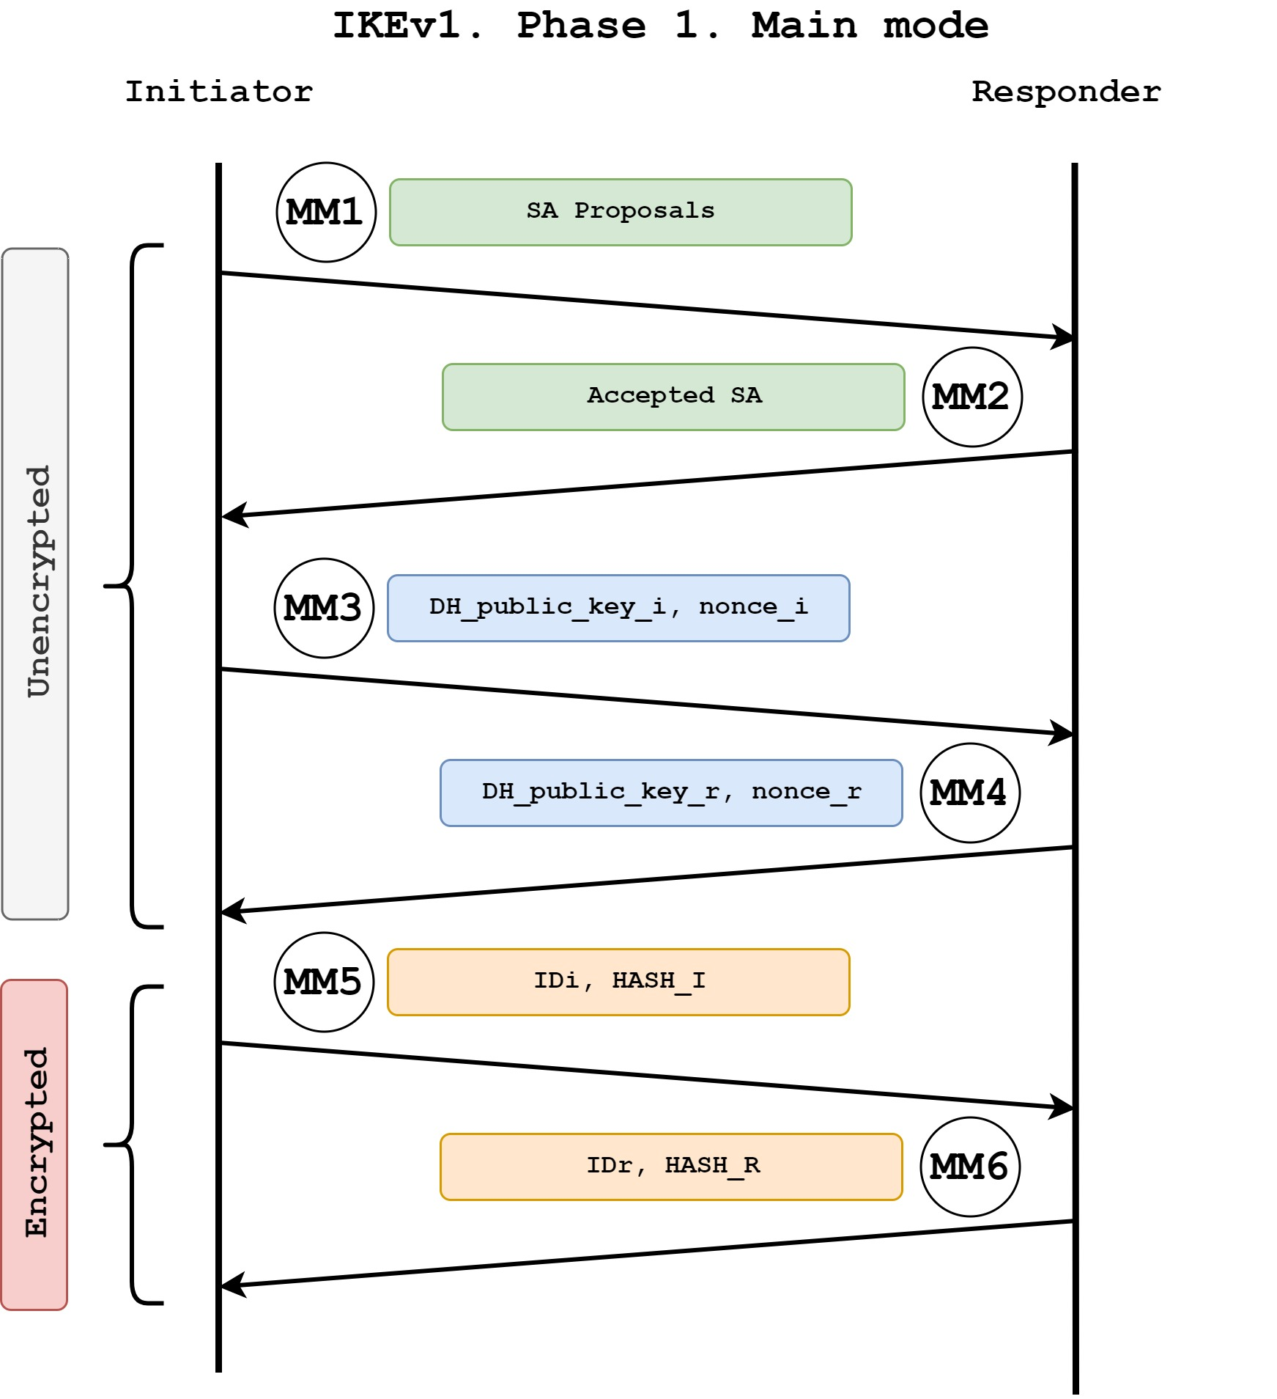
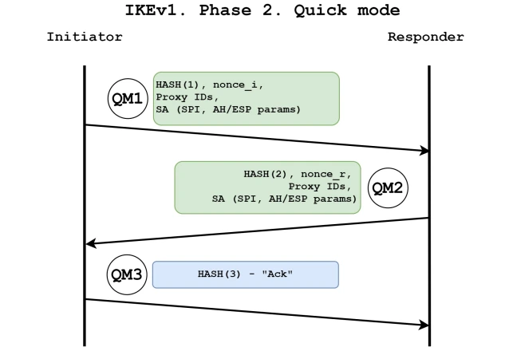
Parameters | Main Mode | Aggressive Mode
Property | Main mode uses six messages to establish SA | It requires three messages to establish the SA.
Speed | It is slower compared to Aggressive mode | It is quicker than main mode.
Protection | Main mode is more secure since identification is encrypted | Aggressive mode does this in clear-text.

Slide 8
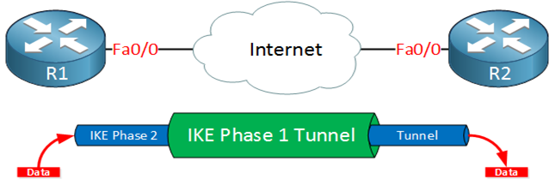
IKE Phase 2
During IKE phase 2 negotiation of IPsec SAs occurs to set up the IPSec tunnel. IKE phase 2 performs the following functions
Negotiates IPSec SA parameters
Establishes IPsec SAs
Periodically renegotiates IPSec SAs
Performs Diffie-Hellman exchange (Optional)
IKE phase 2 has only one mode - Quick mode

Slide 9
IPsec Protocols
There are two protocols that we use to protect user data. Both can be used in transport or tunnel mode
Encapsulating Security Payload (ESP)
Authentication Header (AH)

Slide 10
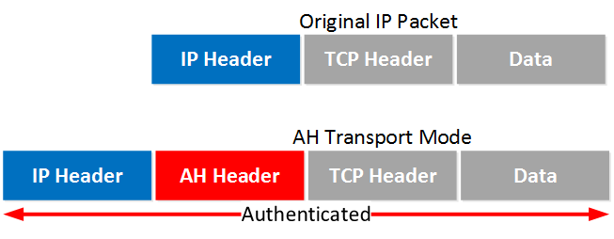
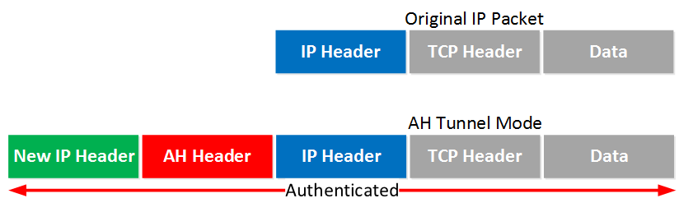
Authentication Header Protocol AH offers authentication and integrity but it doesn’t offer any encryption. It protects the IP packet by calculating a hash value over almost all fields in the IP header.
Transport Mode
AH header is added after the IP header.
Tunnel Mode
New IP header and AH Header is added on top of the original IP packet.

Slide 11
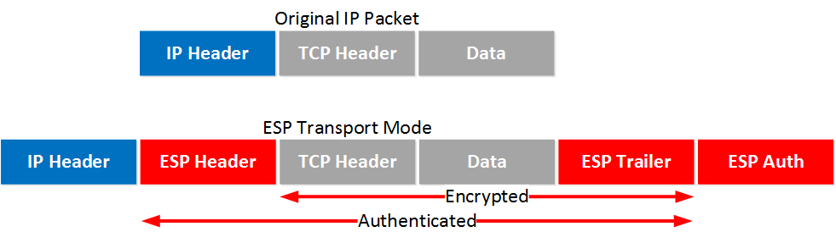
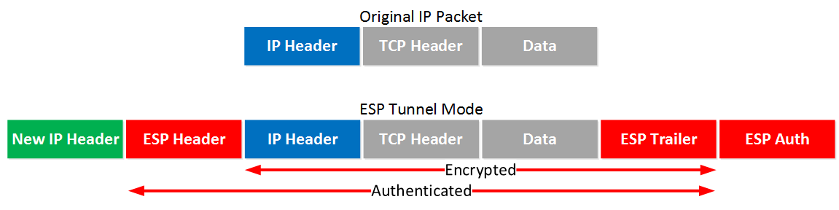
Encapsulating Security Payload Protocol ESP encrypt the IP traffic
Transport Mode
Original IP header is used. ESP header and trailer is added. It also offers authentication but unlike AH.
Tunnel Mode
New IP header, ESP Header and Trailer is added. The original IP header is now also encrypted.

Slide 12
Transport Mode vs. Tunnel Mode
Parameters | Transport Mode | Tunnel Mode
Philosophy | With Transport mode, only the payload of the original IP packet is protected (encrypted, authenticated, or both). The original IP headers remains intact, except that the IP protocol field is changed to be ESP. | With tunnel mode, the entire original IP packet is protected (encrypted, authenticated or both) and encapsulated by the IPsec headers and trailers and then a new IP header is prepended to te packet.
MTU | Larger MTU | Smaller MTU
NAT Traversal | Difficult with NAT traversal (TCP checksum invalidation) | Easier to traverss NAT
Overhead | Lower overhead than tunnel mode | More overhead
Communication end points | Used in securing communication from host to host | Used to tunnel traffic from one site to another
Protection | Protection primarily of upper layer protocols | Protection of entire IP packet

Slide 13
Benefits of IPSec
Encryption on a per-packet rather than per-flow basis.
Good compatibility. You can apply IPsec to all IP-based application systems and services without modifying them.

